Slide 1
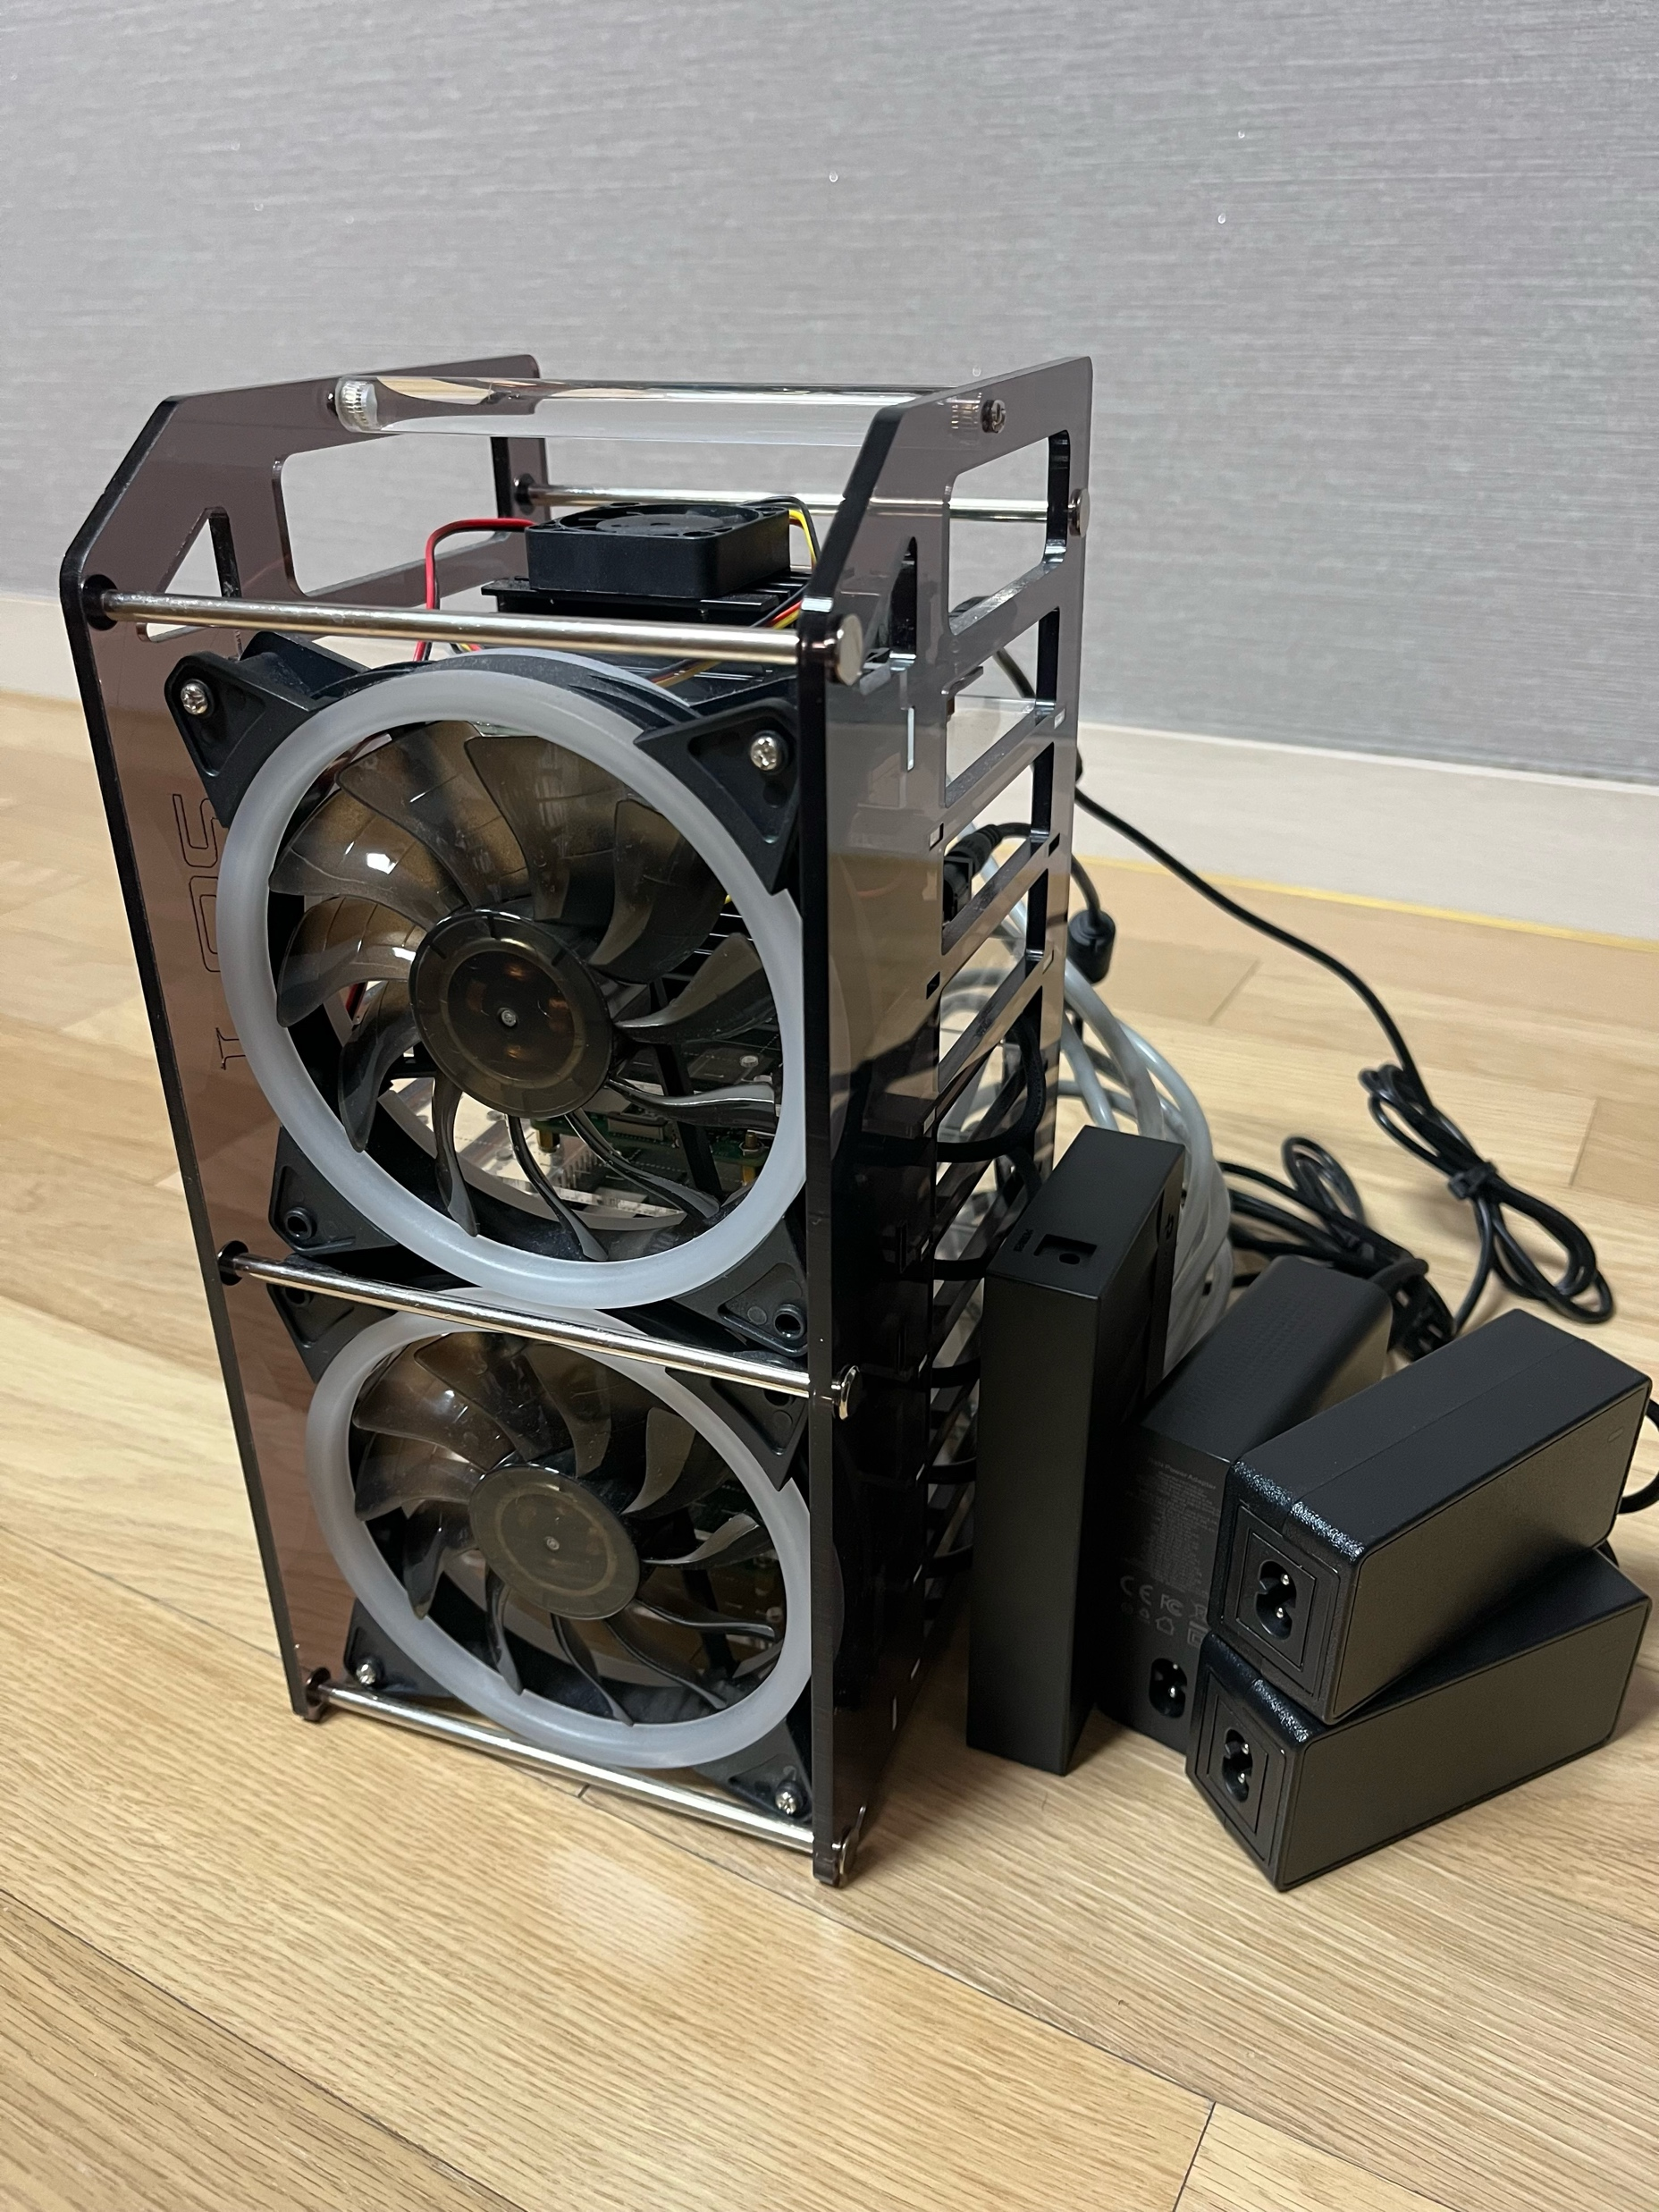
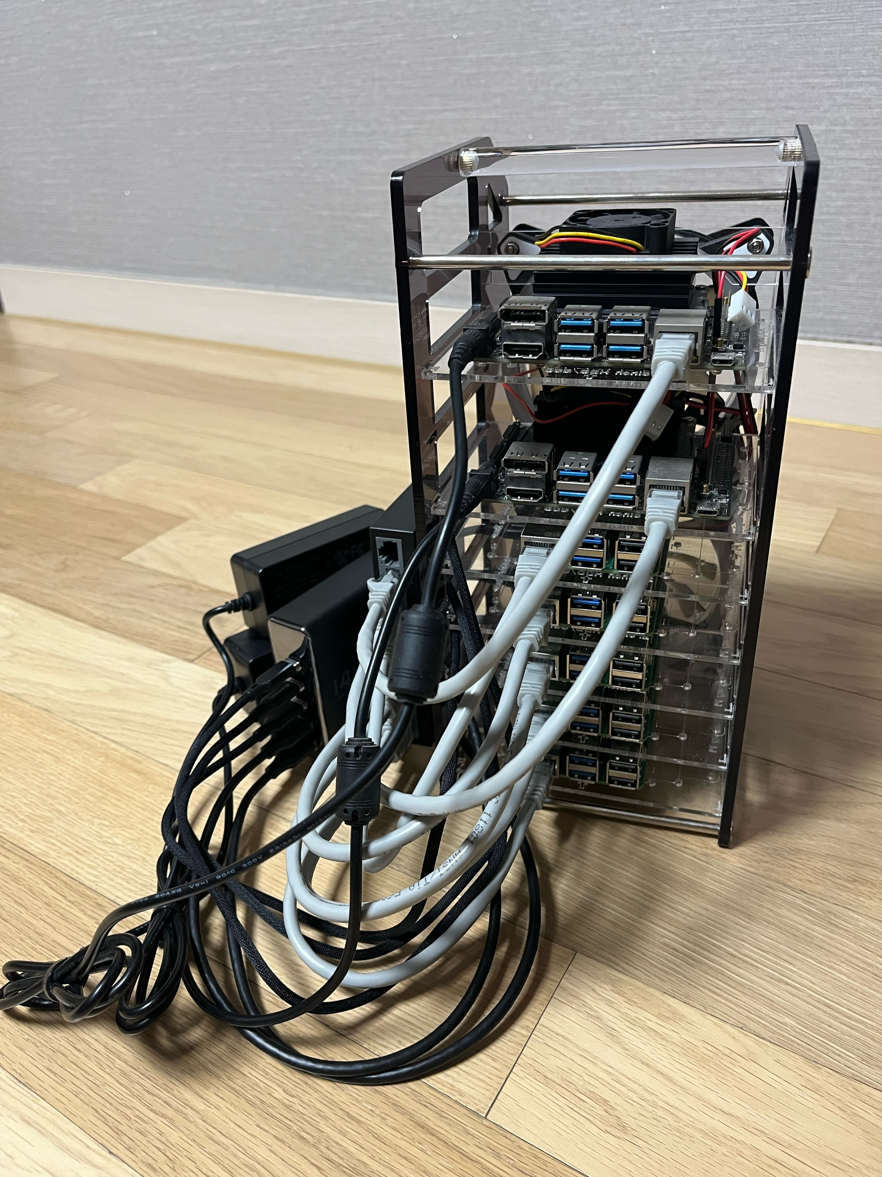

Slide 2
Worker Node Group
Storage Node Group
GPU Node Group
Worker Node 01 / Raspberry Pi 5
CPU : 4 Core Memory : 8 GB
Storage : 64 GB
Network : 192.168.4.42
Storage Node 01 / Raspberry Pi 5
CPU : 4 Core Memory : 8 GB
Storage : 256 GB
Network : 192.168.4.44
GPU Node 01 / Jetson Nano
CPU : 4 Core Memory : 4 GB
Storage : 64 GB
Network : 192.168.4.46
Master Node / Raspberry Pi 5
CPU : 4 Core Memory : 8 GB
Storage : 64 GB
Network : 192.168.4.41
Worker Node 01 / Raspberry Pi 5
CPU : 4 Core Memory : 8 GB
Storage : 64 GB
Network : 192.168.4.43
Storage Node 02 / Raspberry Pi 5
CPU : 4 Core Memory : 8 GB
Storage : 256 GB
Network : 192.168.4.45
GPU Node 02 / Jetson Nano
CPU : 4 Core Memory : 4 GB
Storage : 64 GB
Network : 192.168.4.47

Slide 4
Cluster
Master Node / Raspberry Pi 5
CPU : 4 Core Memory : 8 GB
Storage : 64 GB
Network : 192.168.4.41
etcd
Server
K8s API Server
K8s Controller Manager
K8s Scheduler
K8s
kubelet
K8s
kubelet

